Slide 1
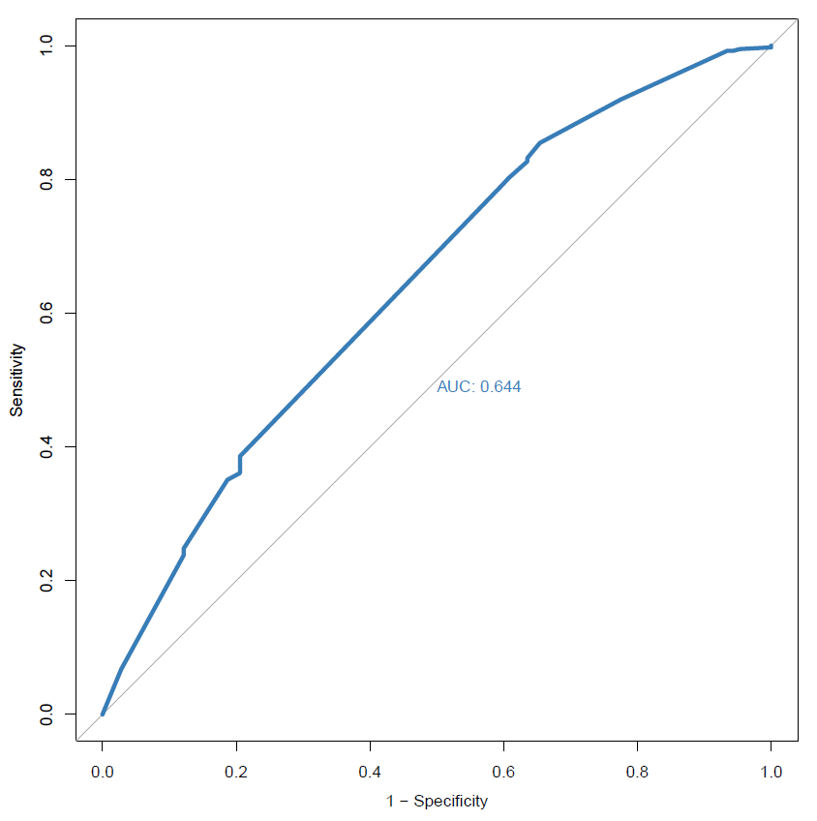
Beyond Survival – Strategies to Promote the Quality of Life of Perinatally HIV Infected Young Adults at Botswana-Baylor Children’s Clinical Centre of Excellence, Botswana.
G. Karugaba, M. Makhele, K. Katse, R. Kgaswane, M. Matshaba
Botswana-Baylor Childrens Clinical Centre of Excellence, BR 129, Gaborone, Botswana
Conclusion:
The determinants of HRQOL in YALPH include viral suppression, no illness, higher education level qualifications and being employed.
Efforts to promote their HRQOL should focus on biomedical and health outcomes and also assist them to acquire higher level education qualifications and to find employment.
Early efforts to promote the HRQOL of YALPH should include the most vulnerable sub-populations identified by the study including those with unsuppressed VL, underweight BMI, those who are neither in school nor working, and young parents.
A multi-disciplinary approach is needed to promote the HRQOL of YALPH in Botswana.
Background:
Due to the successful rollout of the Antiretroviral Therapy Programs in Botswana, perinatally HIV infected adolescents are emerging into young adulthood in large numbers. The presence of a chronic illness such as HIV can interfere with the achievement of developmental milestones and affect Health related Quality of Life. Data from HRQOL assessments can be used to inform and mobilize support for health policies and programming hence incorporating the service recipient’s voice into health care decision making. Limited information exists regarding HRQOL in young adults living with perinatally acquired HIV (YALPH) in Botswana.
Objectives:
To measure HRQOL and to identify the determinants of HRQOL in YALPH in order to inform interventions to promote HRQOL in this population.
Methods:
A cross-sectional survey of the HRQOL among 509 YALPH aged 18-30 years who were enrolled on ART at Botswana-Baylor Children’s Clinical Centre of Excellence, Gaborone, Botswana using the WHOQOL-HIV BREF instrument. Social-demographic information was abstracted from medical records. Bivariate analyses were performed using both the t and chi-square tests to determine the associations between social demographic and clinical factors and the general HRQOL.
Results:
Demographic Characteristics:
Mean age 21.7 years; 50% were males; single (98.1%); secondary to tertiary education qualification (99.6%); lived with family (90.8%), neither in school nor working (47%), and 14% were parents.
Clinical Characteristics: Mean duration on ART (12.4 years) ; 38.5 % were underweight (BMI<18.5 kg/m3); 86.6% had suppressed viral load (<400 copies/mL) ; 86.5% reported good to very good health (self-reported), 17.9% had some illness (self reported).
Scores for General HRQOL and 6 Domains
General HRQOL 3.8 (±0.7)
Physical 15.4 (± 2.9)
Psychological domain 15.0 (± 3.3)
Level of Independence 14.6 (± 2.9)
Social Relationships 14.4 (± 3.6)
Environmental Domain 13.8 (± 2.7)
Spirituality 15.1 (± 3.1)
*General HRQOL, n (%)
Poor 107 (21.0)
Good 399 (78.4)
Missing 3 (0.6)
*General HRQOL ranges from 1 to 5, with 1 corresponding to very poor QOL and 5 corresponding to very good QOL. General QOL score of (3) was used as the cut-off point to define poor and good QOL.
Fig.1 CAfGEN CAB members during their monthly meetings
Determinants of HRQOL:
Based on the p-values < 10%, four factors were significantly associated with the general HRQOL (poor vs good). These factors included highest level of education attained (p=0.012), employment status (0.069), viral load suppression (0.073) and self-reported illness (0.001).
Figure 1 The ROC curve for multivariable logistic regression predicting the general HRQOL
PRESENTED AT THE 23RD INTERNATIONAL AIDS CONFERENCE (AIDS 2020) | 6-10 JULY 2020

